Slide 1
Project Title: IMPROVED HVAC AVAILABILITY AT AGBADA EARLY NAG
Charter Template
Business Case/objectives:
Unavailability of Gas Generators at the Agbada Early NAG facility due to technical faults or extended TNP outage usually results to excessive heat in the Switchboard, battery and Field Auxiliary rooms because the HVAC units are connected to the Main busbar which can only be powered when the Gas Generators are available.
Overheating has resulted in equipment failure in the past, and also poses the threat of fire. The splitting of power supply to the HVAC units in the Field Auxiliary Room, Switchboard and battery rooms between the Main busbar and the Emergency busbar, will ensure power is available for cooling as long as either the Gas Generator or the standby Diesel Generator is operational.
Potential Benefits & Measurement:
Improved Reliability and Availability of equipment.
Assure asset integrity of the ENAG facility and sustain production of circa 23MMscf/d and 2.6kbopd.
Project Scope/Actions:
Feasibility studies.
Obtain MoC approval for the change (MoC 50894)
Cable re-routing from Main to Emergency Busbar.
Testing and commissioning
Updating of Load list and Single Line Diagrams.
Critical Success Factors
Power Generating Capacity
MoC Approval.
Leadership support.
Input High-level Timeline:
L0-L1: Feb 2018 (Initiative Development & Refinement)
L2: 9th March 2018 (Feasibility studies, Risk Assessment and MoC request)
L3: 30th March 2018 (Approval and Signoff)
L4: 30th April 2018 (Re-route power supply, Update of Single line drawings)
L5: June 2018 (Quantify gains and review)
Project Sponsor: Wilcox Emmanuel/Alepaye Babatunde
Implementation Lead: Hart Alaidanengia /Aigiomawu Obehi
Project Team: Isodje Oluseyi, Asooto Afolabi, Wilson Sorka, Opara Sylvester, Essiet Raphael

Slide 2
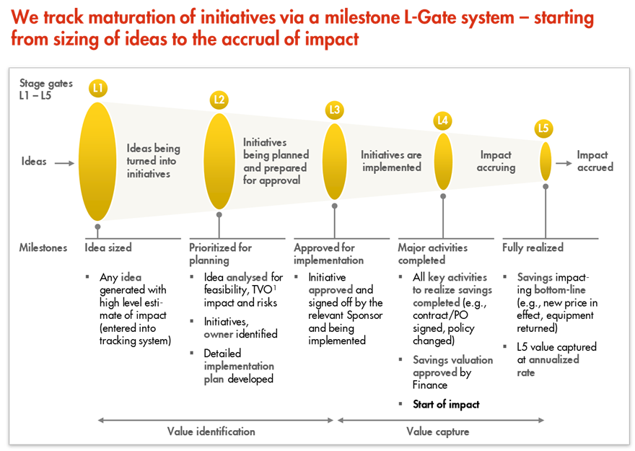
L1 – L5 Gates

